Slide 1
Deployment Practices

Slide 2
Release Management
Agree on release content and date
Agree on release criteria
  e.g Production Readiness Review
Plan for release communication
Backup Plan
People are talking about continuous deployment
Notes:
test

Slide 3
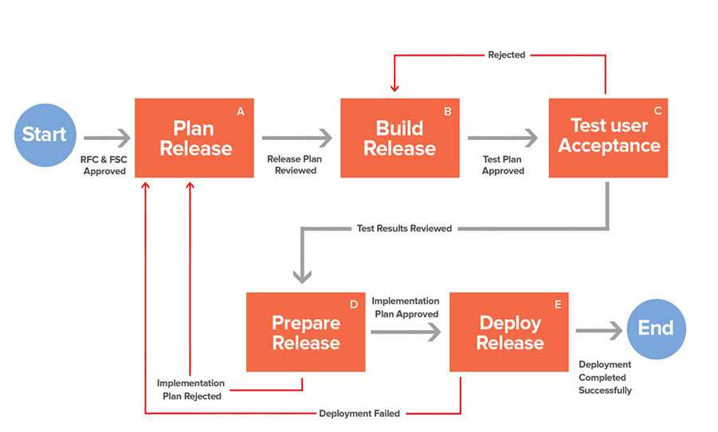
Release Management - Process
Notes:
test

Slide 4
Software Deployment
Traditional Deployment/Installation
  Copying executable manually and do required configuration
  Make file
  Windows paradigm made it a bit easy
    MSI
    Software like InstallShield
Notes:
test

Slide 5
Software Deployment
Traditional Deployment is Operating System specific
Increased Cloud adoption
  Born on cloud application
  Movement of existing application to cloud aka cloud migration
    Gives rise to several challenges
Need of the hour is
  Operating system neutral installation
    Run anywhere
    Easily movable
Notes:
test

Slide 6
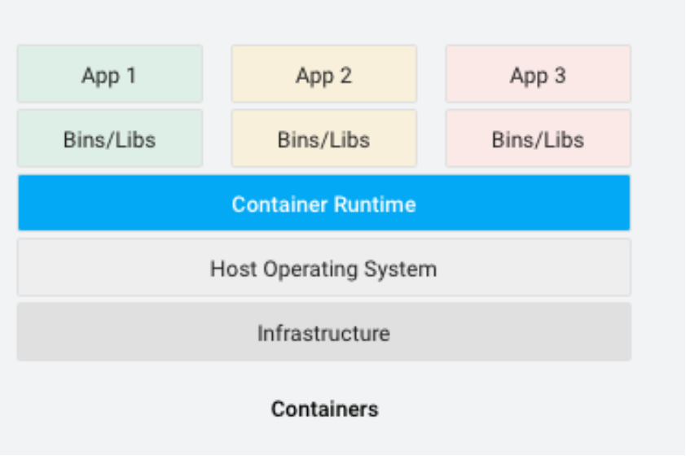
Software Deployment
Container addresses the challenge
  Standard unit of software
    Packages code and all dependencies
  Runs quickly and reliably
  Easily movable from one environment to another
  Docker is most common
    Few others https://www.contino.io/insights/beyond-docker-other-types-of-containers
Notes:
test

Slide 7
Software Deployment
Container advantages
  Consistent environment
  Run anywhere
  Isolation
  Service based Architecture as opposed to Monolithic applications
Container disadvantages
  Management of machines and services
    Availability
    ...
Notes:
test

Slide 8
Software Deployment
Machine and services management is handled by Orchestrators
  Kubernetes
  Docker Swarm
  Apache Mesus
  Prometheus
  https://codecondo.com/orchestration-open-source-docker-tools/
Features
  Automated rollouts and roll backs
  Service health monitoring
  Automatic scaling of services
  Declarative management
  Deploy anywhere, including hybrid deployments
Notes:
test

